Slide 1
“The Cask of Amontillado”
Background for Poe’s Short Story

Slide 2
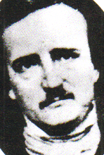
Edgar Allan Poe
Author, not the narrator, of the story “The Cask . . .”
Developed characters whose sanity is questionable.
Father of the genre “the short story”

Slide 3
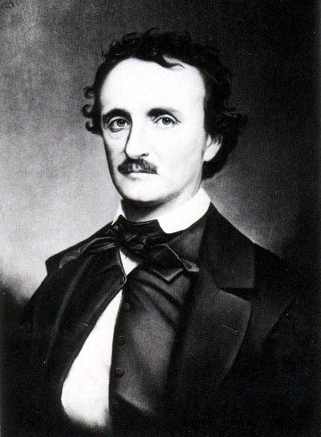
Edgar Allen Poe Bio
Father abandoned family & mother died when he was 2
He was adopted after their death
While in college he became an avid gambler

Slide 4
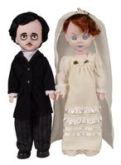
Edgar Allen Poe Bio
He then married his biological cousin, Virginia Clemm– age 13
His brother died of TB
His wife died of TBTB

Slide 5
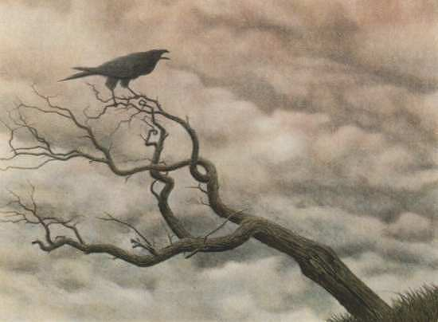
Edgar Allen Poe Bio
Most of his stories deal with death, murder, and even cannibalism!
His poem “The Raven” is his most highly acclaimed work

Slide 6
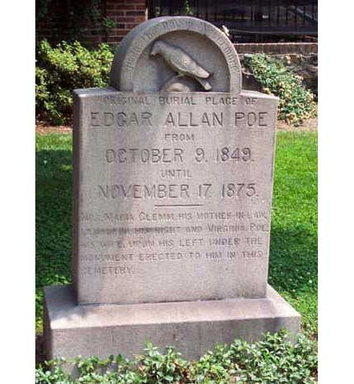
Edgar Allen Poe Bio
It is rumored that he died of an opium overdose or alcoholism
Recent DNA tests show Poe died from Rabies!

Slide 7
“The Cask of Amontillado”
“…but when he ventured upon insult, I vowed revenge.”
“The Cask of Amontillado” is the narrator’s account of his ability to carry out a chilling plot of revenge against his offender.

Slide 8
“The Cask of Amontillado”
Time, place, and setting contribute to the macabre setting of this story and add suspense as Montressor seeks revenge on Fortunato.

Slide 9
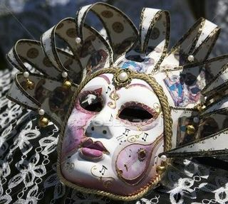
Carnival

Slide 10
Carnival
Carnival is a secular holiday, but it evolved from the Christian observance known as Lent.
Lent is a solemn forty-day period of fasting prior to Easter.

Slide 11
Carnival
Traditionally, the fasting during Lent involves abstaining from eating meat.
Modern interpretations of fasting may involve abstaining from anything one enjoys.

Slide 12
Carn + Val
FLESH (Meat) + FAREWELL
In anticipation of the solemnity of Lent, the celebration of Carnival evolved.
Participants engage in excessive and extreme behavior to bid farewell to meat-eating (and merriment).

Slide 13
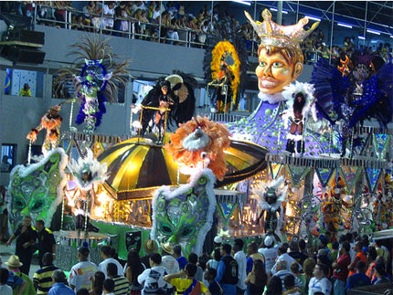
What happens during Carnival?
Carnival is a time of EXCESS and INDULGENCE.
BINGEING upon food and alcohol is common.

Slide 14
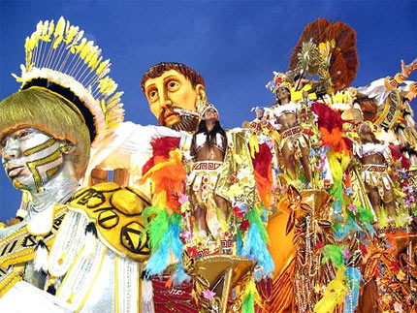
Partying in the Streets & Masquerading are enjoyed

Slide 15
The combination of alcohol and costumes creates an atmosphere where people tend to let down their inhibitions.

Slide 16
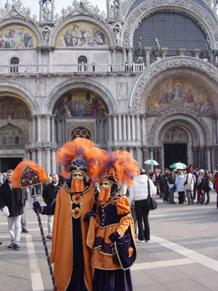
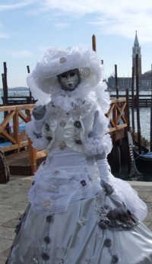

Slide 17
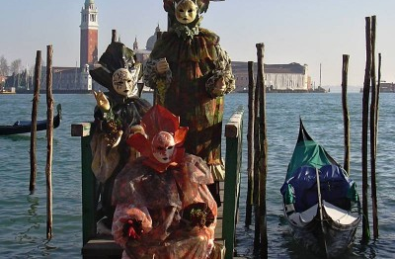

Slide 18
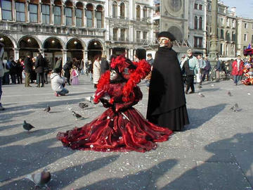
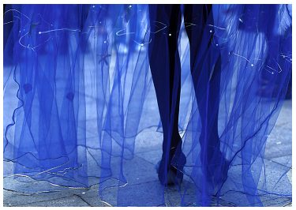
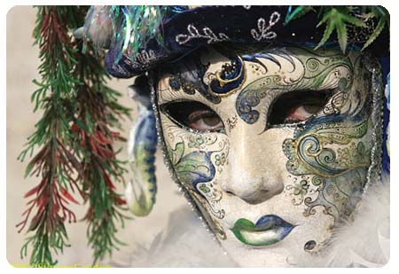
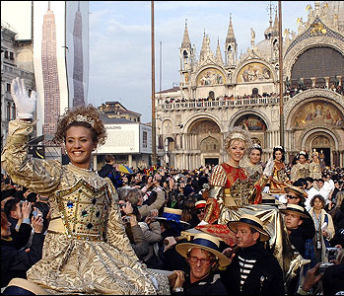

Slide 19
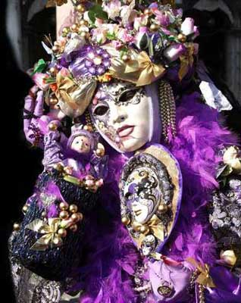

Slide 20
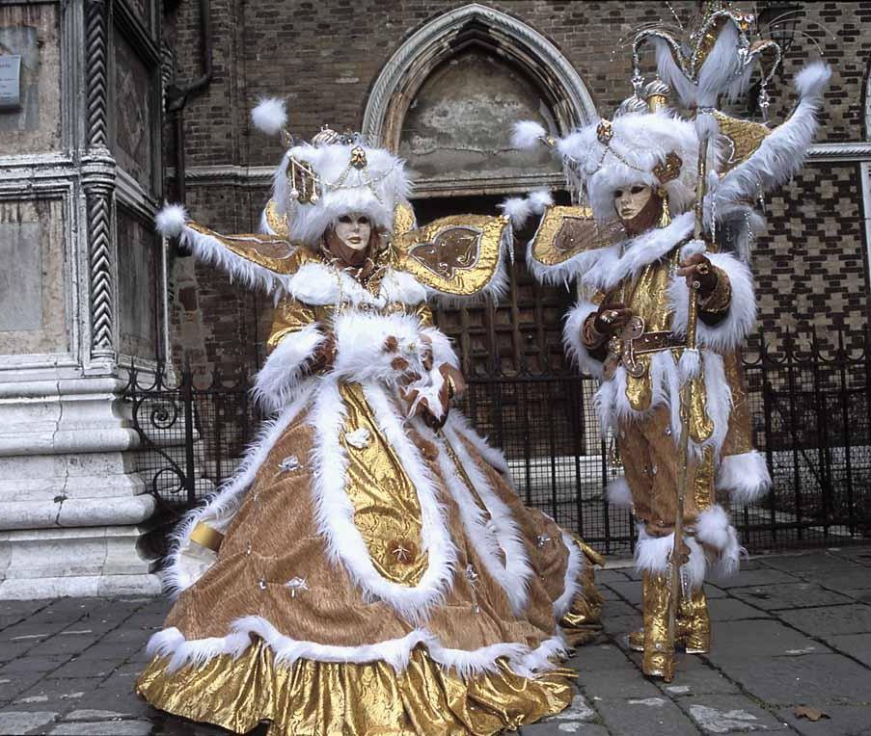

Slide 21
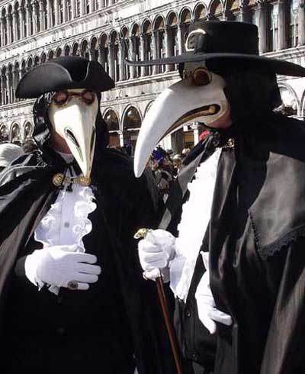

Slide 22
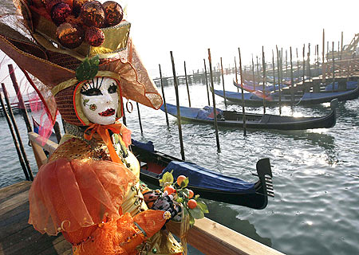

Slide 23
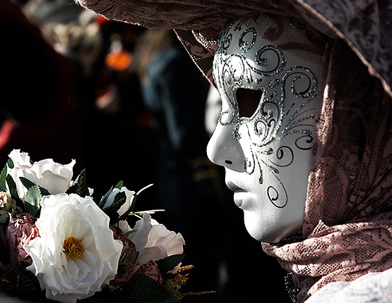

Slide 24
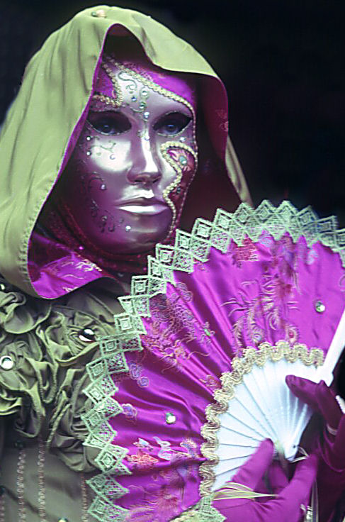
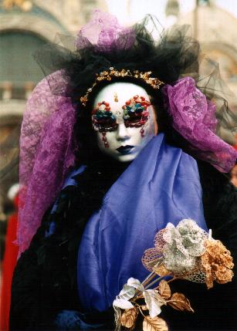

Slide 25
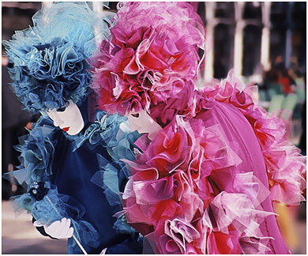

Slide 26
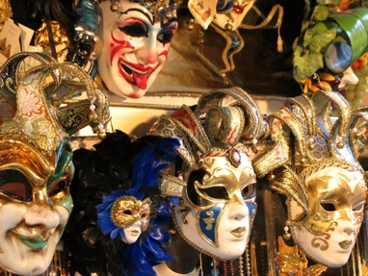

Slide 27
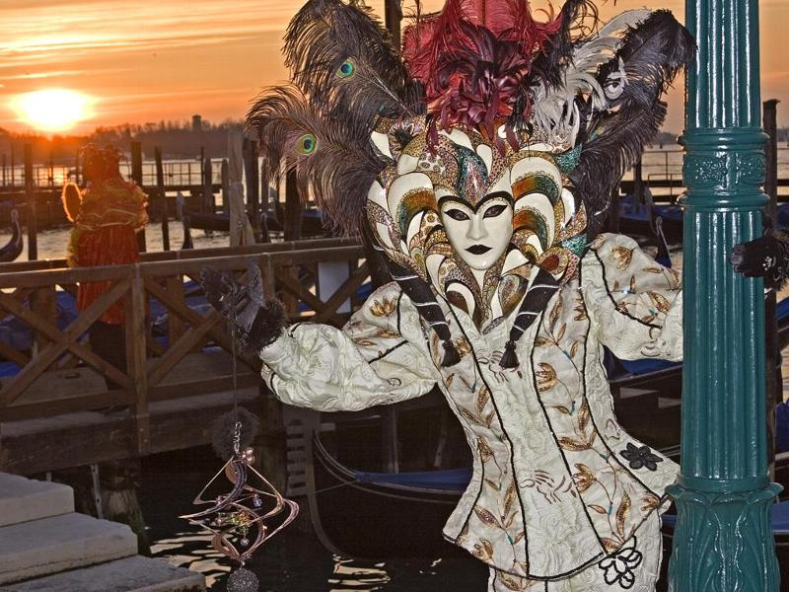

Slide 28
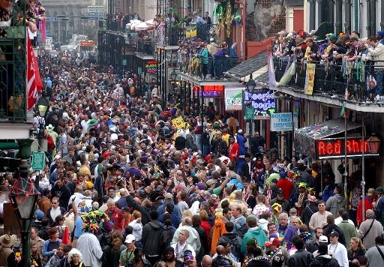
European Carnival traditions survive in the United States in the form of Mardi Gras.

Slide 29
Setting of “Cask. . .”
“The Cask of Amontillado” is set during the “supreme madness” of Carnival.
In such a riotous atmosphere, it is easy to see how a crime could go unnoticed.

Slide 30
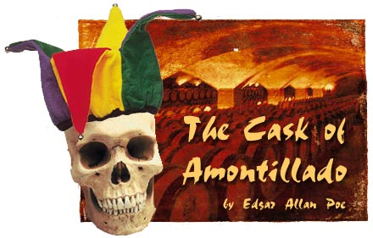
References in
“Cask of Amontillado”

Slide 31
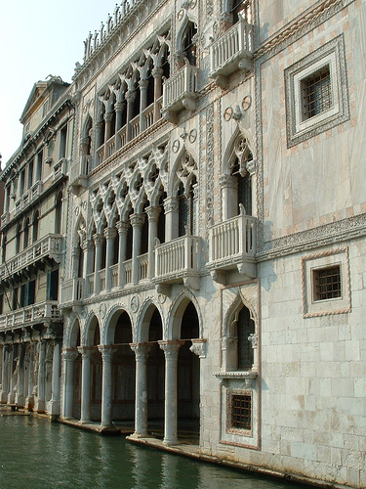
Palazzo – a large, imposing building (as a museum or place of residence) esp. in Italy

Slide 32

Palazzos (mansions)

Slide 33
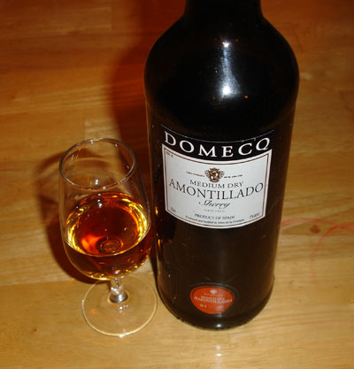
Fine Wine (vintages)

Slide 34
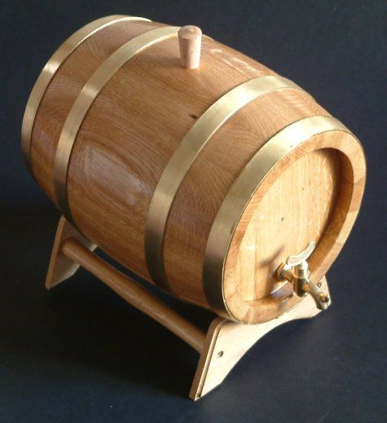
Cask of Wine

Slide 35
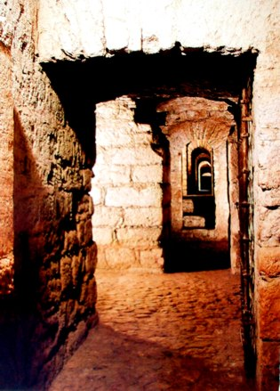
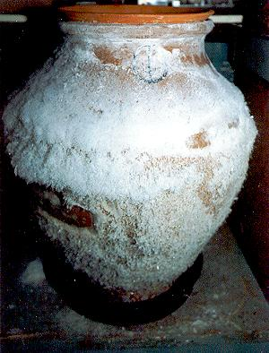
Nitre is a potassium nitrate salt formerly known as saltpeter. Saltpeter is composed of the names “Sal” or salt, and “Petrae” or rock. Literally, salt of the rock.
“…but observe the white webwork which gleams from the these cavern walls.”
Nitre encrusted on an ancient jar
an ancient vault or catacomb

Slide 36
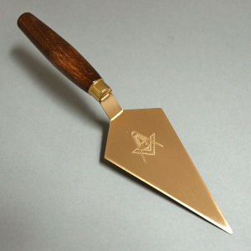
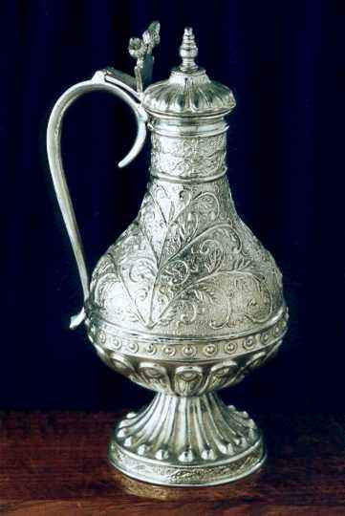
Flagon or vase of De Grave, type of wine
Trowel hand tool used by brick masons

Slide 37
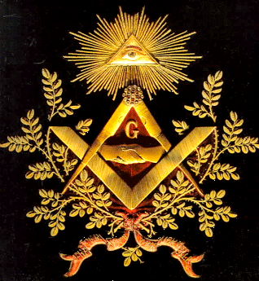
MASONS
Two definitions:
A member of the fraternity of Freemasons, a worldwide fraternal organization
OR
One whose occupation is to build with stone or brick; also, one who prepares stone for building purposes.
Symbol for the Freemasons

Slide 38
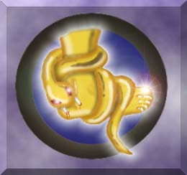
THE FAMILY ARMS
“A huge foot d’or, in a field azure; the foot crushes a serpent rampant whose fangs are imbedded in the heal.”
FAMILY MOTTO
“Nemo me impune lacessit” Translation: “No one provokes me with impunity” /A more colloquial translation into English would be “No one attacks me and gets away with it.”

Slide 39
In “Cask . . .“
The narrator plans for his revenge to take place in the catacombs beneath his estate.
What are catacombs?

Slide 40
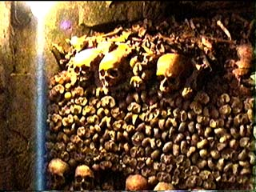
Catacombs: Cities of the Dead

Slide 41
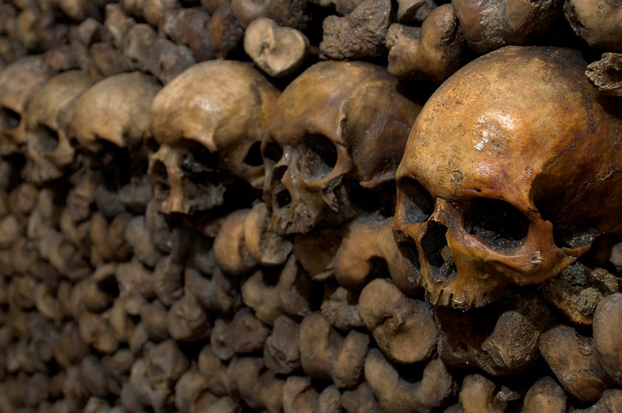

Slide 42
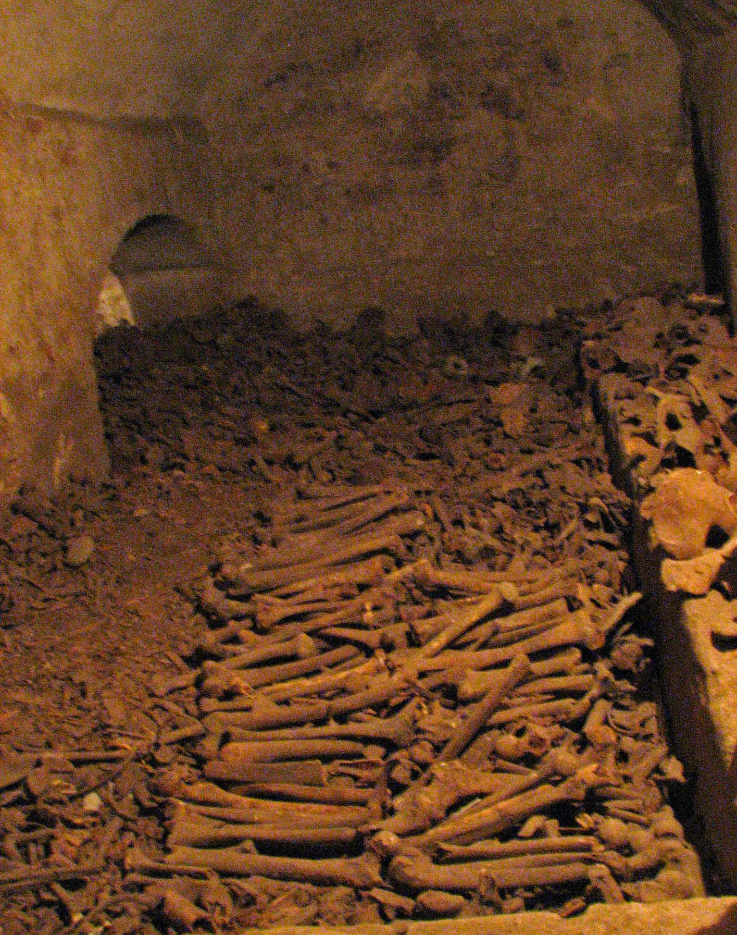
Paris Catacombs
It lies far beneath the city
In it, there are the bones of 5 to 6 million people.
Starting from the late 18th century, lacking in space to put corpses, bodies of people who could not afford proper burials were moved from the overflowing cemeteries and dumped there.

Slide 43
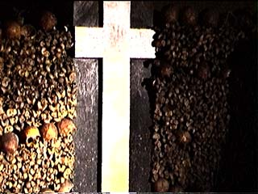
Paris Catacombs
The bones are piled around in heaps that line the walls. Some of the bones are in gigantic stacks.
Some bones are fashioned into macabre configurations: A cross made from femurs

Slide 44
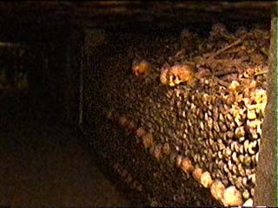
Why Catacombs?
At the end of the 18th century, Paris was greatly overcrowded, flooded with far too many people who had come seeking work or adventure
But there was also a great deal of filth, disease and death, and the influx of new people, often bringing new diseases, filled the city cemeteries to overflowing.

Slide 45
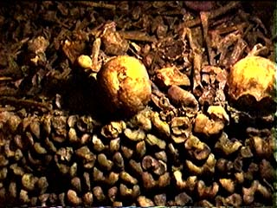
Why Catacombs?
Proper burial became impossible.
People stacked corpses in cemeteries with only a thin layer of dirt over them
The stench of decaying bodies was unbearable and also spreading disease
It was then ordered to find an alternative– thus, catacombs

Slide 46
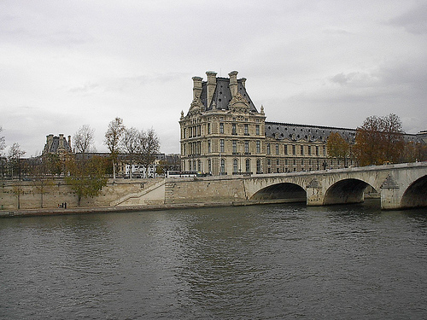
Catacombs & the Wealthy
It was not unusual for wealthy to have catacombs under their estates
They could place the remains of their own family members here

Slide 47
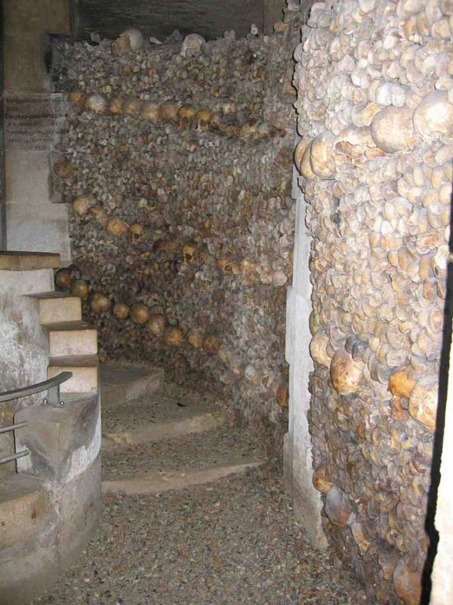

Slide 48
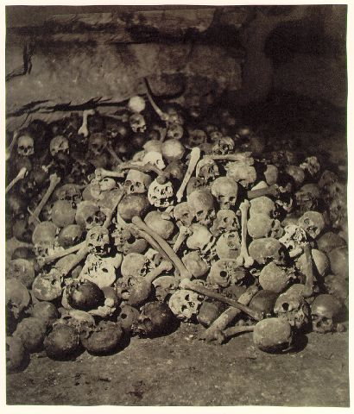

Slide 49
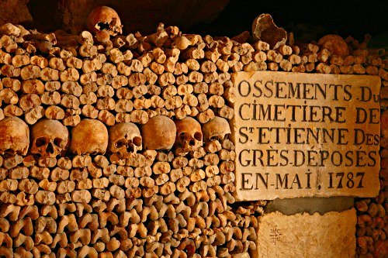

Slide 50
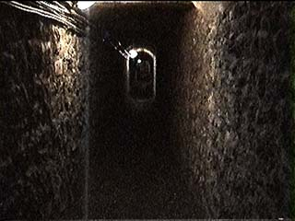
Visiting the Catacombs
It is possible for one to take a tour of the catacombs today.
First, you walk down a long tunnel. . .
And then you see. . .

Slide 51
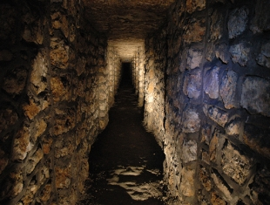

Slide 52
The narrator of “The Cask of Amontillado” carries out his revenge within the catacombs beneath his palazzo.

Slide 53
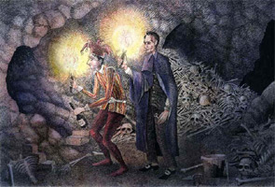

Slide 54
In “The Cask. . .” Montressor lures Fortunato to his catacombs to sample rare amontillado, a type of wine.
Wine was often stored in catacombs because it does well in places where the temperature stays a constant cool year round.

Slide 55
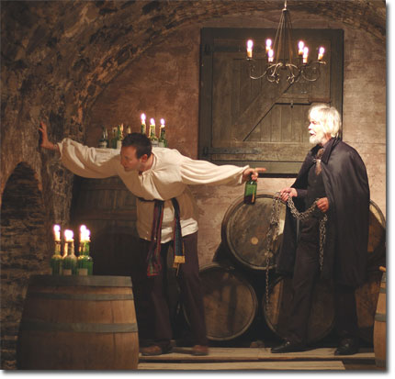

Slide 56
Herein, where wine bottles intermingle with the bones of the dead, the narrator carries out his plan for revenge.
To add to the macabre setting, Carnival– a time of merriment– is occurring just outside Montressor’s home.

Slide 57
Questions for the Reader. . .
Do you think anyone celebrating outside will be able to hear anything occurring in Montressor’s catacombs?
Would you ever dare go to someone’s personal catacombs?

Slide 58

ENJOY!

